Slide 1
Machine Learning Applied to
Software Testing
Parsa Azimi
Summer 2021

Slide 2
PART 1
Introduction

Slide 3

Testing the Software!
Ensuring the reliability of the software that powers our society
One of the factors that contribute the most to budget overruns is fault-detection and fault-correction!
Uncorrected faults become increasingly more expensive
So interest in software testing keeps growing
So what can we do?

Slide 4
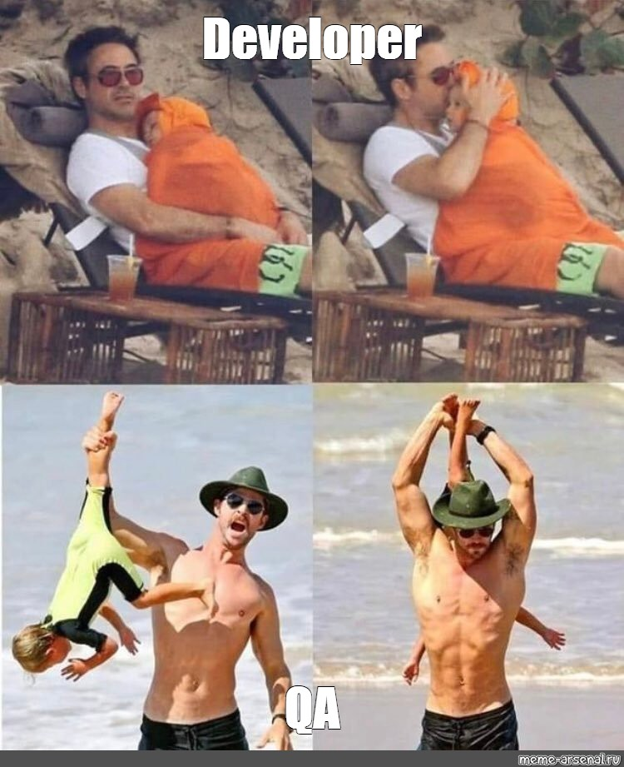
Quality Assurance!
First possible solution, hire people to do this!
QA role responsibility is to find the bugs before the customers
But …
Increased time-to-market
More employees needed
Human errors
And last but not least, they are the Nightmares of Developers...

Slide 5
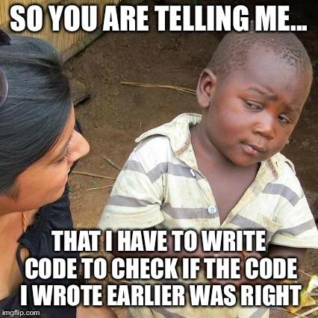
Software Testing to the rescue!
Test the code with the code!
Achieving and Evaluating the quality of software
But software testing is …
Costly
Error-prone
Resource-consuming
Notoriously complex
More than 50% of the total costs of software development!

Slide 6

So now what?

Slide 7
PART 2
Automated Software Testing

Slide 8
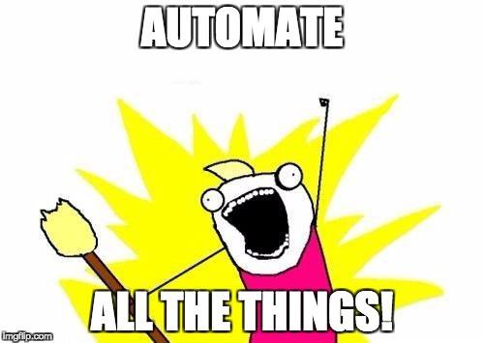
AI to the rescue!
As everywhere else, let’s use AI!
A lot of effort has been put till now
Software testing issues lend themselves to being formulated
Software systems have become increasingly complex, and modern problems need modern solutions!
There has been a growing interest in capitalizing on ML to automate and streamline software testing

Slide 9
Testing Techniques
Functional Testing
black-box testing
internal structure of the SUT is not taken into account
equivalence partitioning and boundary-value analysis
Structural testing
white-box testing
based on the SUT implementation
make sure that all structures of the SUT are exercised during execution of the test suite
Mutation testing
mostly used in academic settings
changing the SUT to mimic mistakes that a competent programmer would make

Slide 10
Where to use ML?
There are many different parts to use it.
Generating unit tests
Mock data Generation
Oracles
Test cases effectiveness

Slide 11
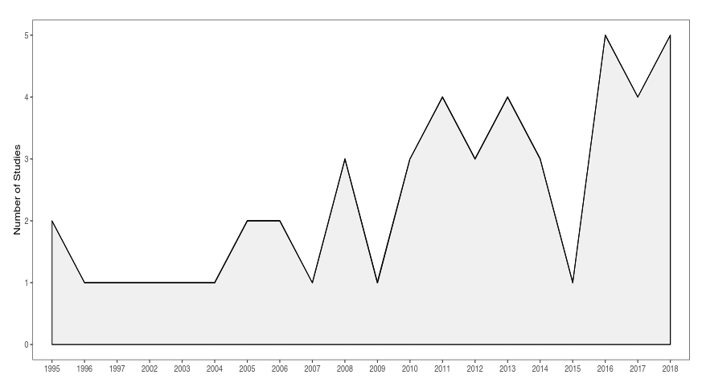

Slide 12
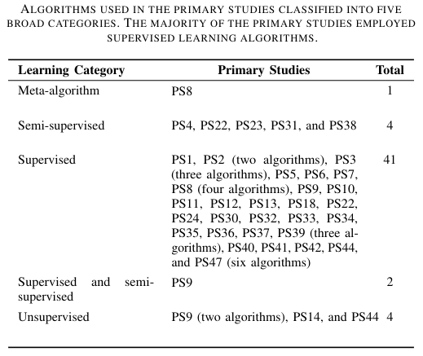

Slide 13
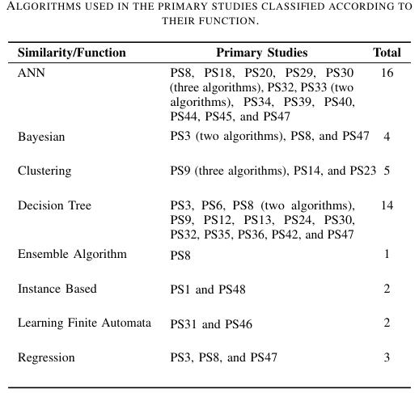

Slide 14
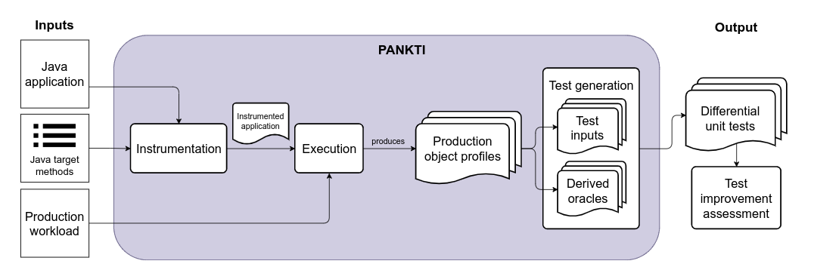
PANKTI

Slide 15
PART 3
Last Words

Slide 16
It is the state-of-the-art!
This topic is very novel
Recent works in previous weeks
There is still much more to do
Many parts to improve
The test oracle problem remains unsolved
We need more experience to see how ML models perform

Slide 17
References
[1] Machine Learning Applied to Software Testing: A Systematic Mapping Study (2019) Vinicius H. S. Durelli, Rafael S. Durelli, Simone S. Borges, Andre T. Endo, Marcelo M. Eler, Diego Dias, and Marcelo P. Guimaraes
[2] Using Machine Learning to Generate Test Oracles: A Systematic Literature Review (2021) Afonso Fontes, Gregory Gay
[3] Production Monitoring to Improve Test Suites (2021) Deepika Tiwari, Long Zhang, Martin Monperrus, and Benoit Baudry

Slide 18
Thanks for your attention!

